Slide 1
An Introduction to Machine Translation

Slide 2
Agenda
What is Machine Translation & why is it interesting?
Machine Translation Paradigms
Word Alignment
Phrase-based SMT

Slide 3
Agenda
What is Machine Translation & why is it interesting?
Machine Translation Paradigms
Word Alignment
Phrase-based SMT
Extensions to Phrase-based SMT
Addressing Word-order Divergence
Addressing Morphological Divergence
Handling Named Entities
Syntax-based SMT
Machine Translation Evaluation
Summary

Slide 4




What is Machine Translation?
Automatic conversion of text/speech from one natural language to another
Be the change you want to see in the world
वह परिवर्तन बनो जो संसार में देखना चाहते हो

Slide 5
Machine Translation Usecases
Government
Administrative requirements
Education
Security
Enterprise
Product manuals
Customer support
Social
Travel (signboards, food)
Entertainment (books, movies, videos)

Slide 6
Why should you study Machine Translation?
One of the most challenging problems in Natural Language Processing
Pushes the boundaries of NLP
Involves analysis as well as synthesis
Involves all layers of NLP: morphology, syntax, semantics, pragmatics, discourse
Theory and techniques in MT are applicable to a wide range of other problems like transliteration, speech recognition and synthesis

Slide 7
Why is Machine Translation interesting?
Language Divergence ➔ the great diversity among languages of the world
The central problem of MT is to bridge this language divergence

Slide 8
Language Divergence
Word order: SOV (Hindi), SVO (English), VSO, OSV
E: Germany won the last World Cup
H: जर्मनी ने पिछला विश्व कप जीता था
Free (Hindi) vs rigid (English) word order
पिछला विश्व कप जर्मनी ने जीता था (correct)
The last World Cup Germany won (grammatically incorrect)
The last World Cup won Germany (meaning changes)
S
V
O
S
O
V

Slide 9
Language Divergence
Different ways of expressing same concept
water → पानी, जल, नीर
Language registers
Formal: आप बैठिये Informal: तू बैठ
Standard : मुझे डोसा चाहिए Dakhini: मेरे को डोसा होना

Slide 10
Why is Machine Translation difficult?
Ambiguity
Same word, multiple meanings: मंत्री (minister or chess piece)
Same meaning, multiple words: जल, पानी, नीर (water)
Word Order
Underlying deeper syntactic structure
Phrase structure grammar?
Computationally intensive
Morphological Richness
Identifying basic units of words

Slide 11
Agenda
What is Machine Translation & why is it interesting?
Machine Translation Paradigms
Word Alignment
Phrase-based SMT

Slide 12
Approaches to build MT systems
Knowledge based, Rule-based MT
Data-driven, Machine Learning based MT
Transfer-based
Interlingua based
Example-based
Statistical
Neural

Slide 13
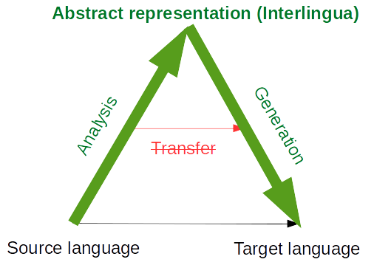
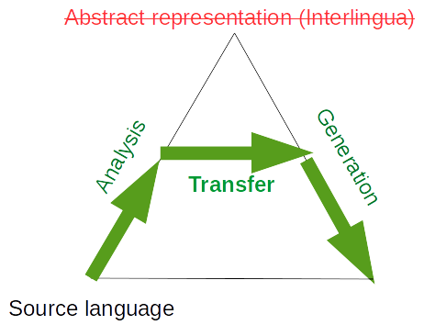
Rule-based MT
Rules are written by linguistic experts to analyze the source, generate an intermediate representation, and generate the target sentence
Depending on the depth of analysis: interlingua or transfer-based MT
Interlingua based MT
Transfer based MT
Deep analysis, complete disambiguation and language independent representation
Partial analysis, partial disambiguation and a bridge intermediate representation

Slide 14
Interlingua
The problem is that different languages categorize the word differently.
Interlingua is a language independent representation, that can be based on any representation scheme.
For example: the French word “doux” covers a wide range of meaning corresponding approximately to the English word “Soft”, “Sweet” and “gentle”. Similarly the English word “hard” covers virtually all uses of the german word “Hart” (Physically, Cruel)
Therefore, Representing the meaning of a sentence is more difficult for translation than it is for single language understanding.
A representation language that makes all the distinctions necessary for the set of languages is called an INTERLINGUA.

Slide 15
Interlingua
Assign a logical form (meaning representation) to sentences
John must not go = OBLIGATORY(NOT(GO(JOHN)))
John may not go = NOT(PERMITTED(GO(JOHN)))
Use logical form to generate a sentence in another language

Slide 16
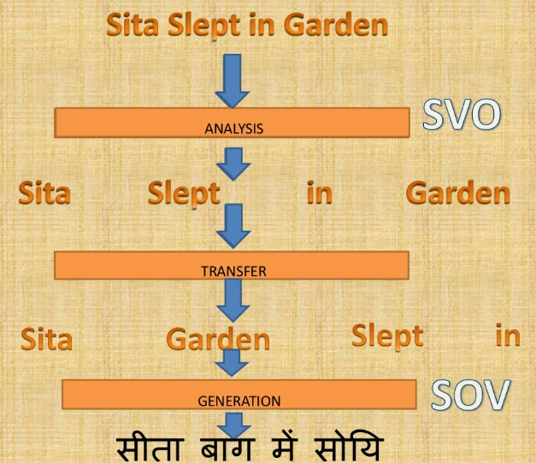
Transfer Based
They keep the database of translation rules and whenever the rules matches. They transfer directly. Transfer can occur at the lexical, syntactic or semantic level

Slide 17
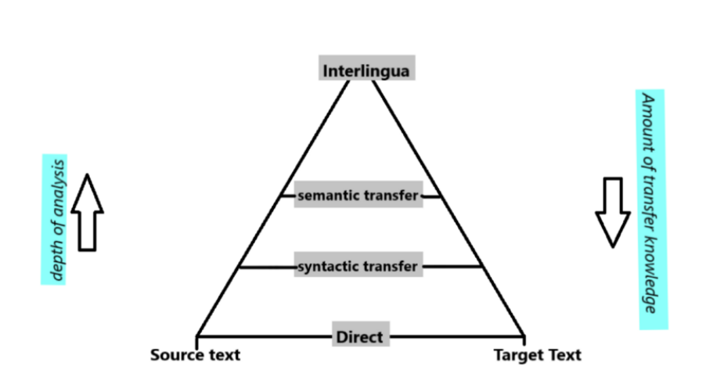
Vauquois Triangle
Translation approaches can be classified by the depth of linguistic analysis they perform

Slide 18
The Interlingual approach first analyzes the source language sentence, represents it as an Interlingua, and then generates the target language sentence from this interlingua. Interlingua is a language independent representation, that can be based on any representation scheme.

Slide 19
Problems with rule-based MT
Required linguistic expertise to develop systems
Maintenance of system is difficult
Difficult to handle ambiguity
Scaling to a large number of language pairs is not easy

Slide 20
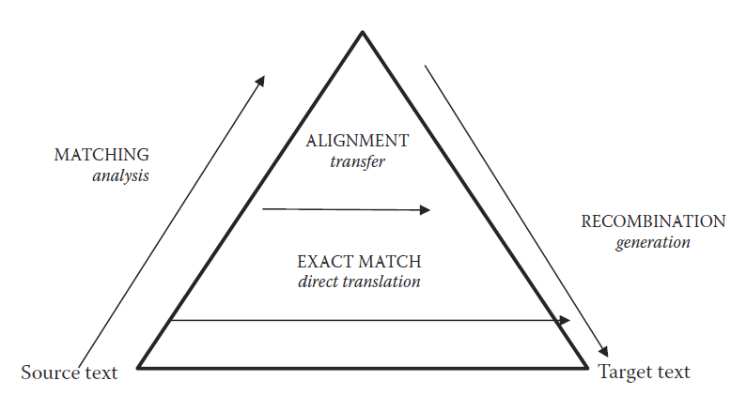
Example-based MT
Translation by analogy ⇒ match parts of sentences to known translations and then combine
Input: He buys a book on international politics
Phrase fragment matching: (data-driven)
he buys
a book
international politics
Translation of segments: (data-driven)
वह खरीदता है
एक किताब
अंतर राष्ट्रीय राजनीति
Recombination: (human crafted rules/templates)
वह अंतर राष्ट्रीय राजनीति पर एक किताब खरीदता है
Partly rule-based, partly data-driven.
Good methods for matching and large corpora did not exist when proposed

Slide 21
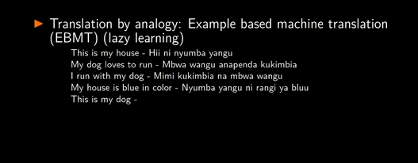
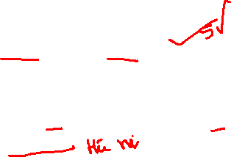

Slide 22
Approaches to build MT systems
Knowledge based, Rule-based MT
Data-driven, Machine Learning based MT
Transfer-based
Interlingua based
Example-based
Statistical
Neural

Slide 23
Statistical Machine Translation
A Probabilistic Formalism

Slide 24
Find most probable English sentence given a foreign language sentence.
Automatically align words and phrases within sentence pairs in a parallel corpus
Probabilities are determined automatically by training a statistical model using the parallel corpus (pdf of parallel corpus)

Slide 25
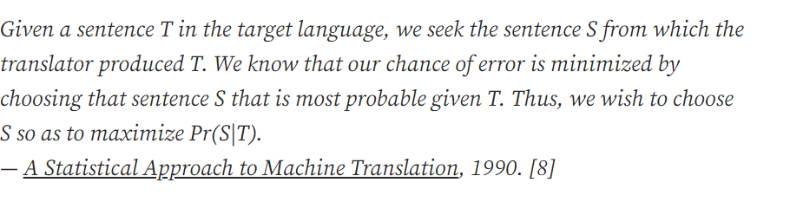

Slide 26
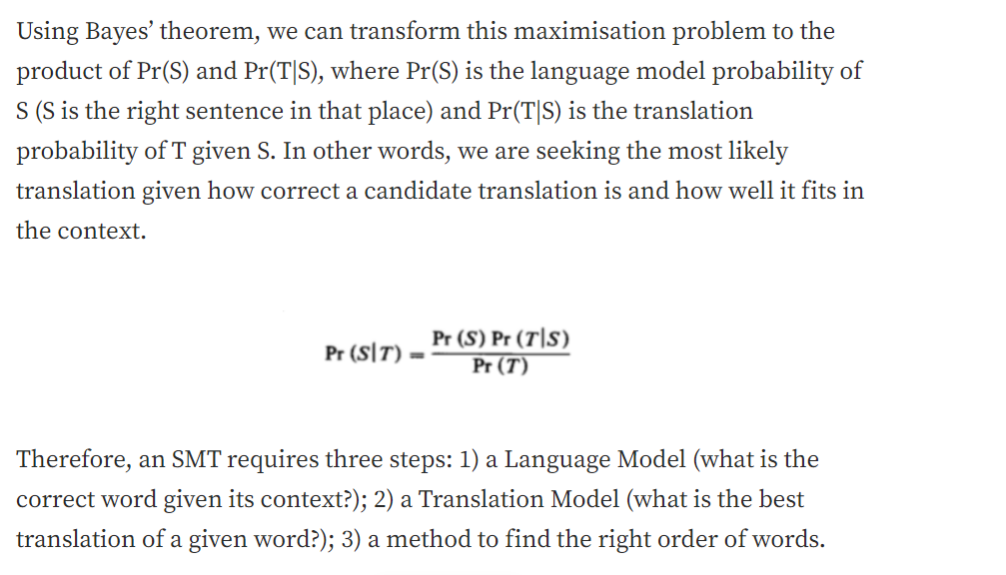

Slide 27
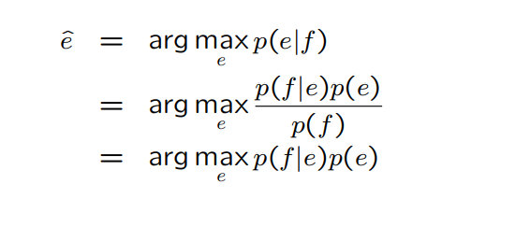
Probabilities
• Find the most probable English sentence given a foreign language sentence (this is often how the problem is framed - of course can be generalised to any language pair in any direction)

Slide 28
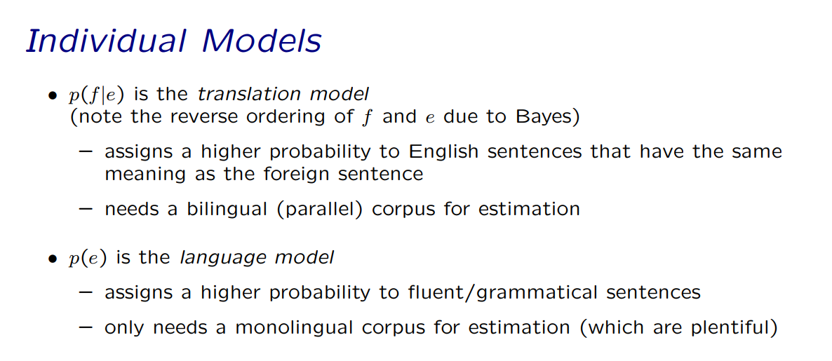

Slide 29
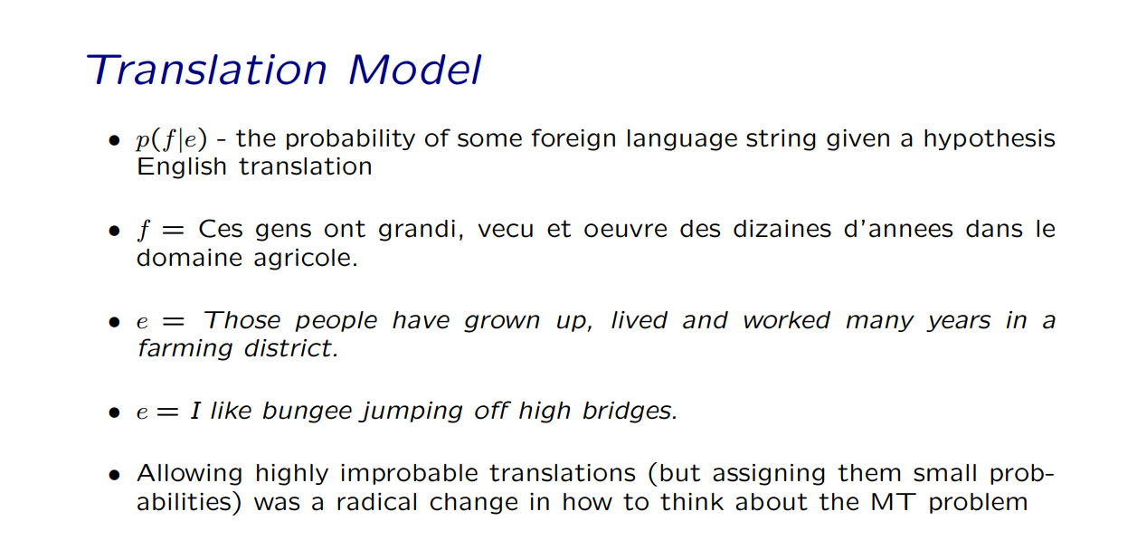

Slide 30
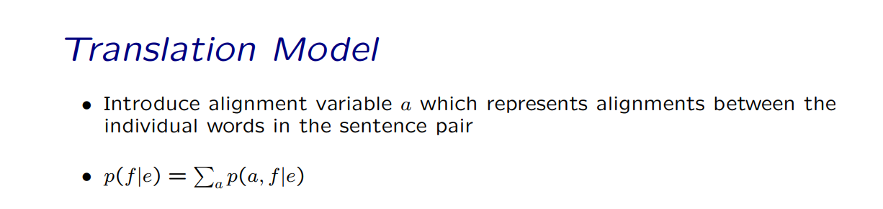

Slide 31
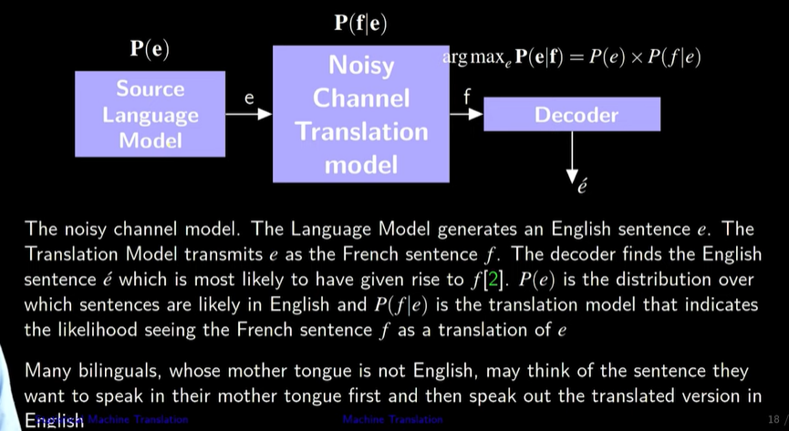

Slide 32
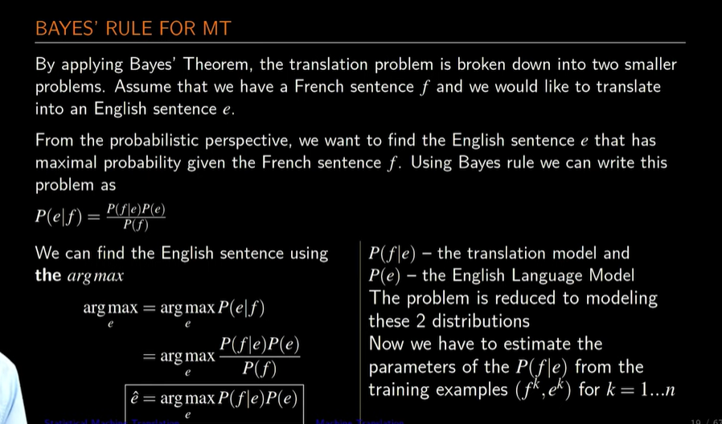

Slide 33
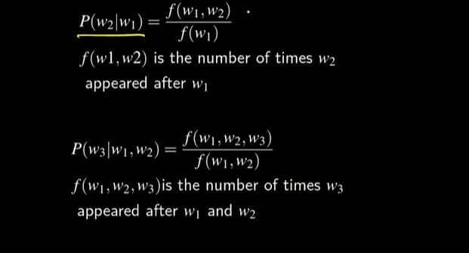

Slide 34
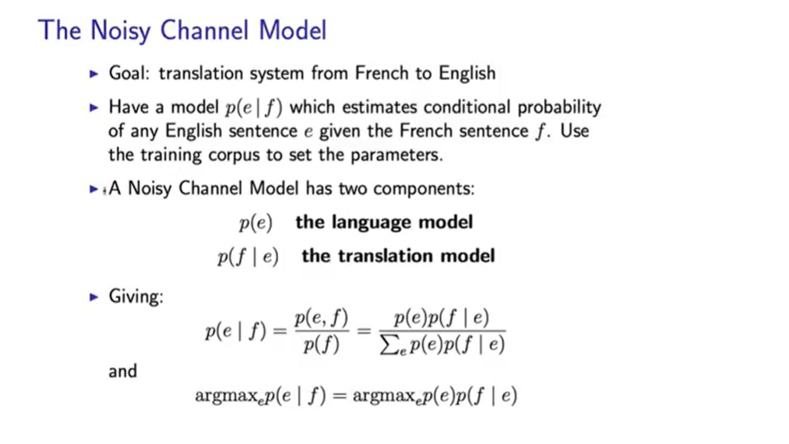

Slide 35

Let’s formalize the translation process
We will model translation using a probabilistic model. Why?
We would like to have a measure of confidence for the translations we learn
We would like to model uncertainty in translation
E: target language e: source language sentence
F: source language f : target language sentence
How do we model this quantity?
Best translation
Model: a simplified and idealized understanding of a physical process
We must first explain the process of translation

Slide 36
We have already seen how to learn n-gram language models
Let’s see how to learn the translation model → $P(f|e)$
To learn sentence translation probabilities,
→ we first need to learn word-level translation probabilities
That is the task of word alignment

Slide 37
Agenda
What is Machine Translation & why is it interesting?
Machine Translation Paradigms
Word Alignment
Phrase-based SMT

Slide 38
A parallel text is a corpus of text that expresses the same meaning in two (or more) different languages. Usually we assume that a parallel text is already sentence-aligned, that is, it consists of sentence pairs, each of which expresses the same meaning in two languages. Conventionally, following Brown et al. (1993), the two languages are referred to as English and French even when other languages are possible. Our example uses English and Spanish.
Here is an example parallel text:
1. garcia and associates
garcia y asociados
2. his associates are not strong
sus asociados no son fuertes
The word alignment problem is to figure out which French (Spanish) words correspond to which English words. This would be the correct word alignment for our example:

Slide 39
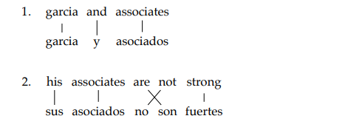
More formally: let
f = f1 · · · fm range over French sentences
e = e1 · · · eℓ range over English sentences
a = (a1, . . . , am) range over possible many-to-one alignments, where aj = i means that French word j is aligned to English word i, and aj = NULL means that French word j is unaligned. Thus the alignment for sentence (2) above is (1, 2, 4, 3, 5).
We are given a sequence of (f, e) pairs. We are going to define a model of P(f, a | e) and our job is to estimate the parameters of the model to maximize the likelihood P(f | e).

Slide 40
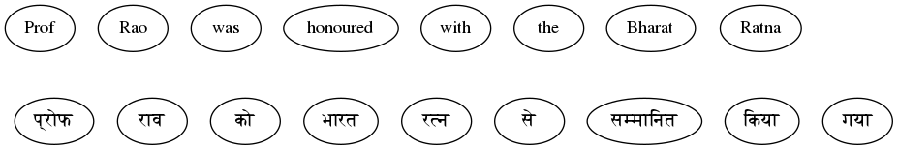
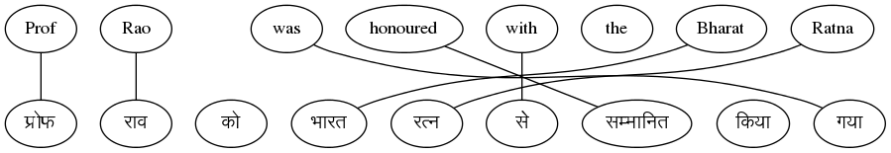
Given a parallel sentence pair, find word level correspondences
This set of links for a sentence pair is called an ‘ALIGNMENT’

Slide 41
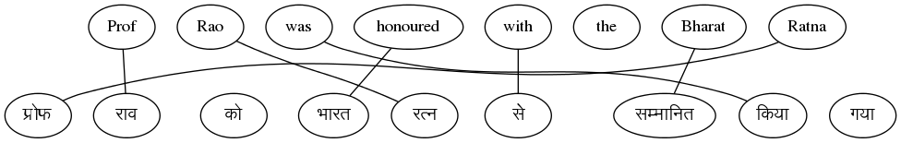
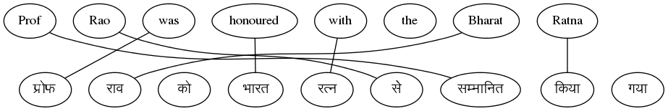
But there are multiple possible alignments
Sentence 1
With one sentence pair, we cannot find the correct alignment

Slide 42
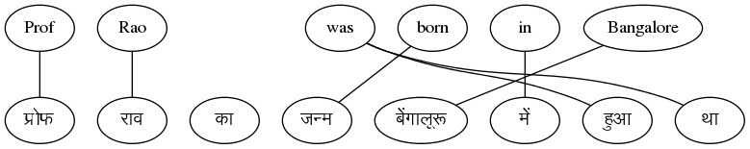
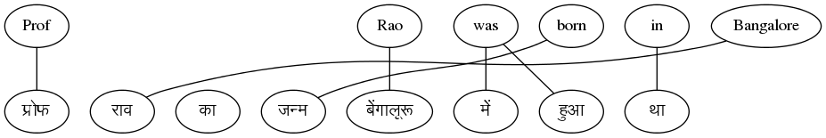
Can we find alignments if we have multiple sentence pairs?
Sentence 2
Yes, let’s see how to do that …

Slide 43
Parallel Corpus
A boy is sitting in the kitchen | एक लडका रसोई मे़ बैठा है
A boy is playing tennis | एक लडका टेनिस खेल रहा है
A boy is sitting on a round table | एक लडका एक गोल मेज पर बैठा है
Some men are watching tennis | कुछ आदमी टेनिस देख रहे है
A girl is holding a black book | एक लडकी ने एक काली किताब पकडी है
Two men are watching a movie | दो आदमी चलचित्र देख रहे है
A woman is reading a book | एक औरत एक किताब पढ रही है
A woman is sitting in a red car | एक औरत एक काले कार मे बैठी है

Slide 44
Parallel Corpus
A boy is sitting in the kitchen | एक लडका रसोई मे़ बैठा है
A boy is playing tennis | एक लडका टेनिस खेल रहा है
A boy is sitting on a round table | एक लडका एक गोल मेज पर बैठा है
Some men are watching tennis | कुछ आदमी टेनिस देख रहे है
A girl is holding a black book | एक लडकी ने एक काली किताब पकडी है
Two men are watching a movie | दो आदमी चलचित्र देख रहे है
A woman is reading a book | एक औरत एक किताब पढ रही है
A woman is sitting in a red car | एक औरत एक काले कार मे बैठा है
Key Idea
Co-occurrence of translated words
Words which occur together in the parallel sentence are likely to be translations (higher P(f|e))

Slide 45
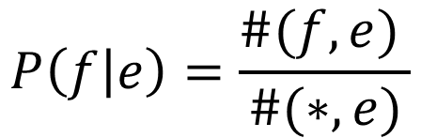
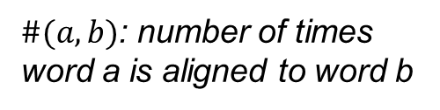
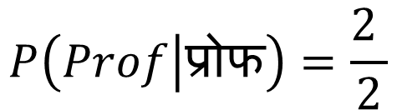
If we knew the alignments, we could compute P(f|e)
Sentence 1
Sentence 2
$$P\left(f | e\right)=\frac{\#(f,e) }{\#(∗,e)}$$
$$P\left(Prof | प्रोफ\right)=\frac{2 }{2}$$
$\#(a,b)$: number of times word a is aligned to word b

Slide 46
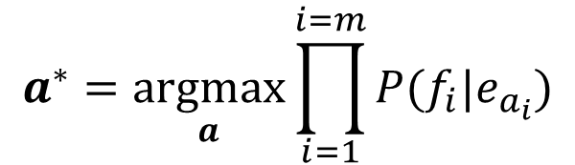
But, we can find the best alignment only if we know the word translation probabilities
The best alignment is the one that maximizes the sentence translation probability
$$a^{∗}=\underset{a}{argmax}{\prod_{i=1}^{i=m}{P(f_{i}|e_{a_{i}})}}$$
$P(f,a|e)=P(a)\prod_{i=1}^{i=m}{P\left(f_{i} | e_{a_{i}}\right)}$
This is a chicken and egg problem! How do we solve this?

Slide 47
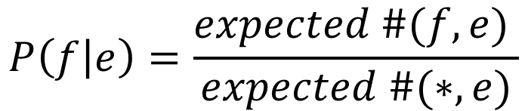
We can solve this problem using a two-step, iterative process
Start with random values for word translation probabilities
Step 1: Estimate alignment probabilities using word translation probabilities
Step 2: Re-estimate word translation probabilities
- We don’t know the best alignment
- So, we consider all alignments while estimating word translation probabilities
- Instead of taking only the best alignment, we consider all alignments and weigh the word alignments with the alignment probabilities
$$P\left(f | e\right)=\frac{expected \#(f,e) }{expected \#(∗,e)}$$
Repeat Steps (1) and (2) till the parameters converge

Slide 48
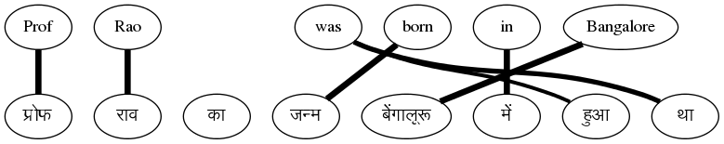
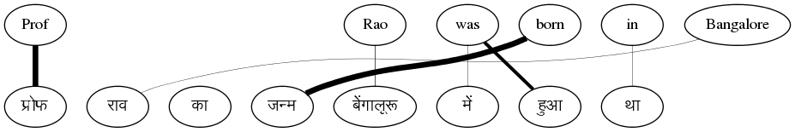
At the end of the process …
Sentence 2

Slide 49
Is the algorithm guaranteed to converge?
That’s the nice part → it is guaranteed to converge
This is an example of the well known Expectation-Maximization Algorithm
However, the problem is highly non-convex
Will lead to local minima
Good modelling assumptions necessary to ensure a good solution

Slide 50
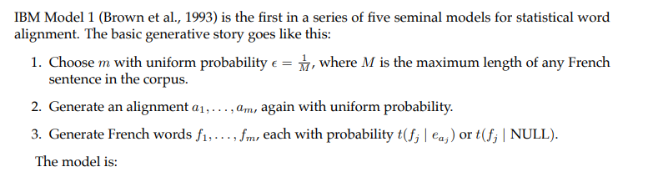
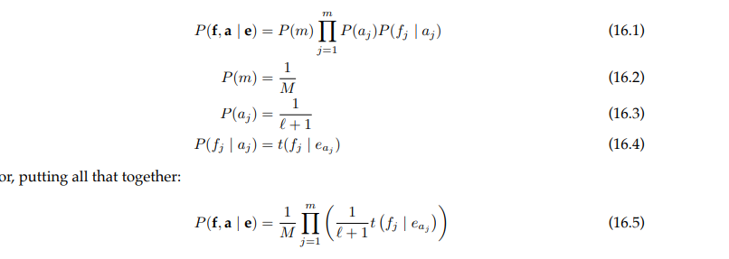
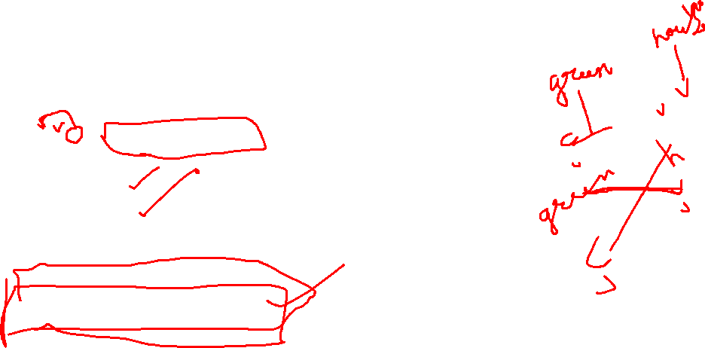
Model 1

Slide 51
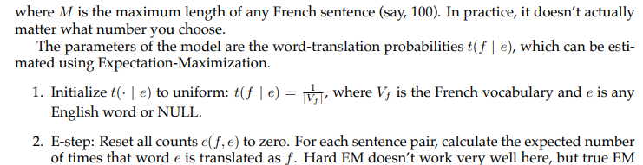

Slide 52
Agenda
What is Machine Translation & why is it interesting?
Machine Translation Paradigms
Word Alignment
Phrase-based SMT

Slide 53
What is PB-SMT?
Why stop at learning word correspondences?
KEY IDEA ➔ Use “Phrase” (Sequence of Words) as the basic translation unit
Note: the term ‘phrase’ is not used in a linguistic sense
The Prime Minister of India | भारत के प्रधान मंत्री bhArata ke pradhAna maMtrI India of Prime Minister
is running fast | तेज भाग रहा है teja bhAg rahA hai fast run -continuous is
honoured with | से सम्मानित किया se sammanita kiyA with honoured did
Rahul lost the match | राहुल मुकाबला हार गया rAhula mukAbalA hAra gayA Rahul match lost

Slide 54
Parallel Corpus
A boy is sitting in the kitchen | एक लडका रसोई मे़ बैठा है
A boy is playing tennis | एक लडका टेनिस खेल रहा है
A boy is sitting on a round table | एक लडका एक गोल मेज पर बैठा है
Some men are watching tennis | कुछ आदमी टेनिस देख रहे है
A girl is holding a black book | एक लडकी ने एक काली किताब पकडी है
Two men are watching a movie | दो आदमी चलचित्र देख रहे है
A woman is reading a book | एक औरत एक किताब पढ रही है
A woman is sitting in a red car | एक औरत एक काले कार मे बैठा है

Slide 55
Benefits of PB-SMT
Local Reordering → Intra-phrase re-ordering can be memorized
The Prime Minister of India | भारत के प्रधान मंत्री bhaarat ke pradhaan maMtrI India of Prime Minister
Sense disambiguation based on local context → Neighbouring words help make the choice
heads towards Pune | पुणे की ओर जा रहे है pune ki or jaa rahe hai Pune towards go –continuous is
heads the committee | समिति की अध्यक्षता करते है Samiti kii adhyakshata karte hai committee of leading -verbalizer is

Slide 56
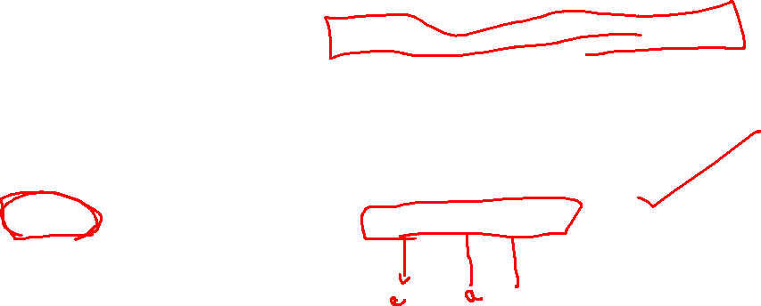
Benefits of PB-SMT (2)
Handling institutionalized expressions
Institutionalized expressions, idioms can be learnt as a single unit
Improved Fluency
The phrases can be arbitrarily long (even entire sentences)
hung assembly | त्रिशंकु विधानसभा trishanku vidhaansabha
Home Minister | गृह मंत्री gruh mantrii
Exit poll | चुनाव बाद सर्वेक्षण chunav baad sarvekshana

Slide 57
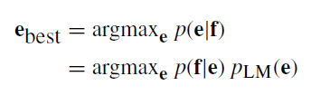


Mathematical Model
Let’s revisit the decision rule for SMT model
Let’s revisit the translation model p(f|e)
Source sentence can be segmented in I phrases
Then, p(f|e) can be decomposed as:
Distortion probability
Phrase Translation Probability
start_{i} :start position in f of i^{th} phrase of e
end_{i} :end position in f of i^{th} phrase of e

Slide 58
Learning The Phrase Translation Model
Involves Structure + Parameter Learning:
Learn the Phrase Table: the central data structure in PB-SMT
Learn the Phrase Translation Probabilities
The Prime Minister of India | भारत के प्रधान मंत्री
is running fast | तेज भाग रहा है
the boy with the telescope | दूरबीन से लड़के को
Rahul lost the match | राहुल मुकाबला हार गया
Prime Minister of India | भारत के प्रधान मंत्री India of Prime Minister | 0.75
Prime Minister of India | भारत के भूतपूर्व प्रधान मंत्री India of former Prime Minister | 0.02
Prime Minister of India | प्रधान मंत्री Prime Minister | 0.23

Slide 59
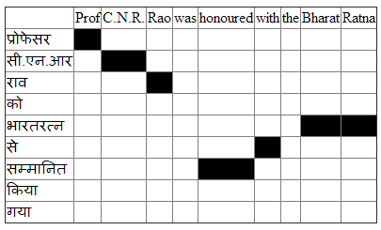
Learning Phrase Tables from Word Alignments
Start with word alignments
Word Alignment : reliable input for phrase table learning
high accuracy reported for many language pairs
Central Idea: A consecutive sequence of aligned words constitutes a “phrase pair”
Which phrase pairs to include in the phrase table?

Slide 60
Extracting Phrase Pairs

Slide 61
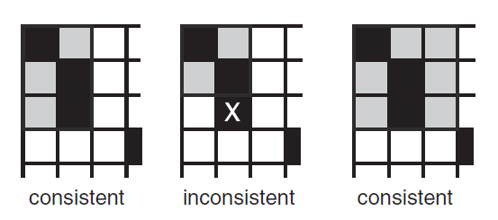


Phrase Pairs “consistent” with word alignment
Source: SMT, Phillip Koehn

Slide 62
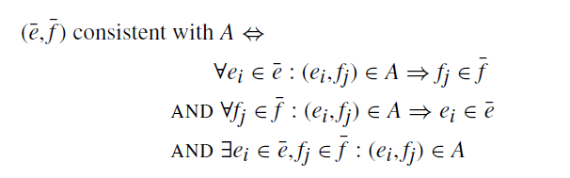
Phrase Pairs “consistent” with word alignment

Slide 63
Examples
26 phrase pairs can be extracted from this table
Professor CNR | प्रोफेसर सी.एन.आर
Professor CNR Rao | प्रोफेसर सी.एन.आर राव
Professor CNR Rao was | प्रोफेसर सी.एन.आर राव
Professor CNR Rao was | प्रोफेसर सी.एन.आर राव को
honoured with the Bharat Ratna | भारतरत्न से सम्मानित
honoured with the Bharat Ratna | भारतरत्न से सम्मानित किया
honoured with the Bharat Ratna | भारतरत्न से सम्मानित किया गया
honoured with the Bharat Ratna | को भारतरत्न से सम्मानित किया गया

Slide 64

Computing Phrase Translation Probabilities
Estimated from the relative frequency:
Prime Minister of India | भारत के प्रधान मंत्री India of Prime Minister | 0.75
Prime Minister of India | भारत के भूतपूर्व प्रधान मंत्री India of former Prime Minister | 0.02
Prime Minister of India | प्रधान मंत्री Prime Minister | 0.23

Slide 65


Generative vs. Discriminative models in ML
Generative Model
Discriminative Model
Maximum Entropy based model, incorporating arbitrary features
h_{i} - features functions, λ_{i} are feature weights
No need to model source, reduces parameter space
Arbitrary features can better capture translation process
Why exponential function form? –maximizing entropy w.r.t data constraints
Noisy channel model of translation from sentence f to sentence e.
Task is to recover e from noisy f.
P(f|e): Translation model, addresses adequacy
P(e): Language model, addresses fluency
Joint modeling of entire parameter space
The generative story is too simplistic, not reflective of translation process

Slide 66


Discriminative Training of PB-SMT
Directly model the posterior probability p(e|f)
Use the Maximum Entropy framework
h_{i}(f,e) are feature functions , λ_{i}’s are feature weights
Benefits:
Can add arbitrary features to score the translations
Can assign different weight for each features
Assumptions of generative model may be incorrect
Notes:
P(\mathbf{e|f})=\exp\left( \sum_i \lambda_i h_i(f_1^I,e_1^J)\right)

Slide 67


Generative Model as a special case
Generative model
translation model
Feature function mappings
for corresponding discriminative
model
distortion model
language model
Notes:
h_1=\prod_{i=1}^{I}\phi(\bar{f_i},\bar{e_i}) \;\;\; , \;\;\; \lambda_1=1

Slide 68

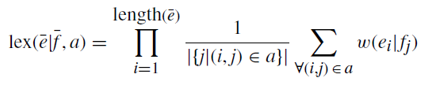
More features for PB-SMT
Inverse phrase translation probability ( )
Lexical Weighting
a: alignment between words in phrase pair (ē, f)
w(x|y): word translation probability
Inverse Lexical Weighting
Same as above, in the other direction

Slide 69
An Example of Translation
Ram ate rice with the spoon
राम ने
चम्मच से
चावल
खाये

Slide 70
Reality
We picked the phrase translation that made sense to us
The computer has less intuition
Phrase table may give many options to translate the input sentence
Ram ate rice with the spoon
राम
खाये
धान
के साथ
यह
चमचा
राम ने
खा लिया
चावल
से
वह
चम्मच
राम को
खा लिया है
एक
राम से
चम्मच
चम्मच से
चम्मच के साथ

Slide 71
What is the challenge in decoding?
The task of decoding in machine translation is to find the best scoring translation according to translation models
Hard problem, since there is a exponential number of choices, given a specific input sentence
Shown as an NP complete problem
Need to come up with heuristic search methods
No guarantee of finding the best translation

Slide 72
Search Space and Search Organization
Partial Hypothesis
Hypothesis Expansion
खा लिया
Final Hypothesis
राम ने
चम्मच से
चावल
चावल
खाये
चम्मच
Incremental construction
Each hypothesis is scored using the odel
Hypotheses are maintained in a priority queue
Limit to the reordering window for efficiency
Empty Hypothesis

